Slide 1

Supermarket Delta
2019 performance
Key FINDINGs, insights AND PREDICTIONS

Slide 2
PROBLEM STATEMENT
Given a historical sales dataset spanning three months, we want to:
use the data gathered on customer behaviour to make more informed decisions to increase conversions
understand how our supermarket has been performing over the last year, and
what we can do to improve sales in 2020.

Slide 3
OVERVIEW
Sales recorded in 3 different branches for 3 months (January to March 2019)
Types of customers: members and normal (non-members)
Product line: Electronic accessories, Fashion accessories, Food and beverages, Health and beauty, Home and lifestyle, Sports and travel
Three methods of payments: cash, credit card, ewallet
Purchase time: 10 am to 9 pm
Customer satisfaction rating: 1 - 10

Slide 4
METHODOLOGY FOR DATA ANALYSIS AND PREDICTIONS
Machine Learning with libraries
For exploratory data analysis:
Library for linear algebra: numpy
Library for data processing: pandas
Libraries for data visualisation: matplotlib and seaborn
For sales prediction:
Method 1: Decision Tree
Method 2: Random Forest

Slide 5

PART 1: ANALYSIS OF CURRENT TRENDS

Slide 6



ANALYSIS
Sales
Customers
Products

Slide 7
ANALYSIS FOR SALES

Slide 8
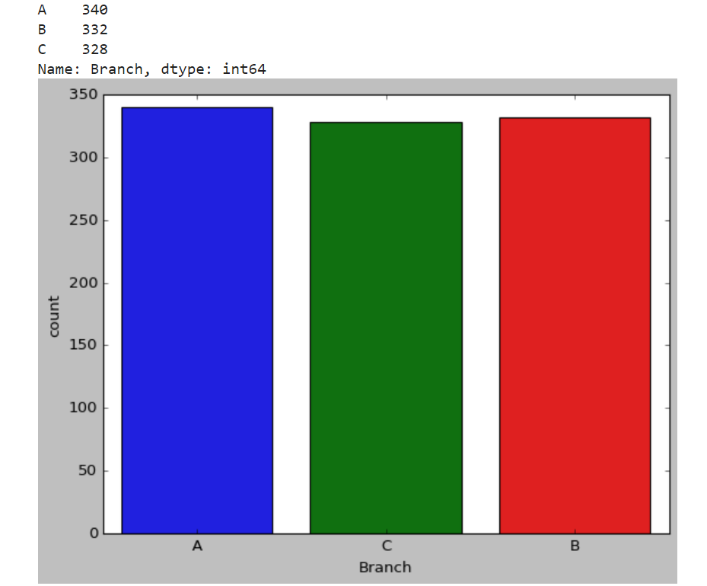
KEY FINDINGS: SALES Sales in different branches
The branches:
Branch A: Yangon
Branch B: Mandalay
Branch C: Naypyitaw
Sales in Branch A is a bit higher than the rest
Otherwise not much difference

Slide 9
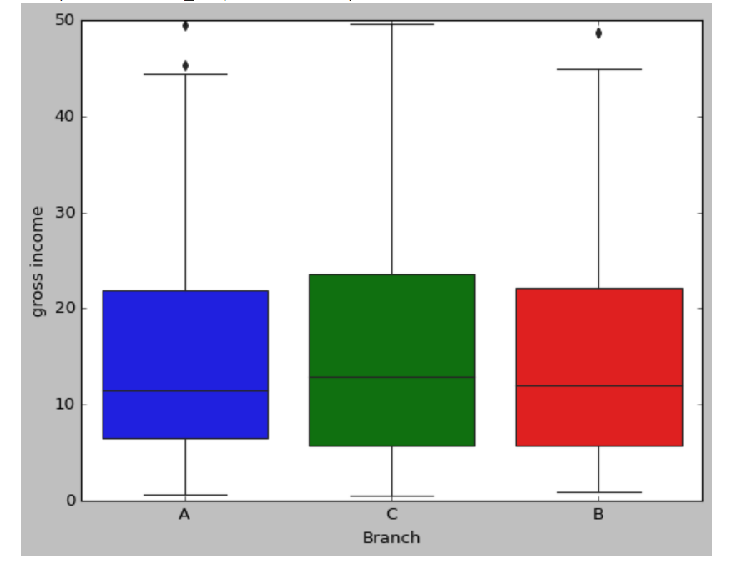
KEY FINDINGS: SALES Which branch is the most profitable?
There is not much difference in gross
income by branches at an average level.
Branch C has a slightly higher income
than A or B.
Although branch A has slightly higher
sales than the rest, Branch C (Naypyitaw) is the most profitable branch in terms of
gross income.

Slide 10
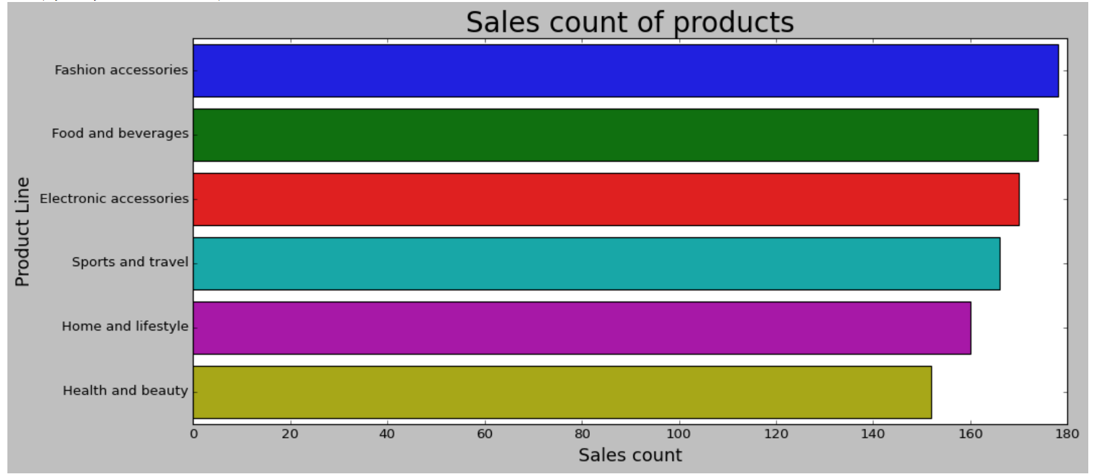
KEY FINDINGS: PRODUCTS Sales count of products
Fashion accessories lead the race
Health and beauty makes the least sales

Slide 11
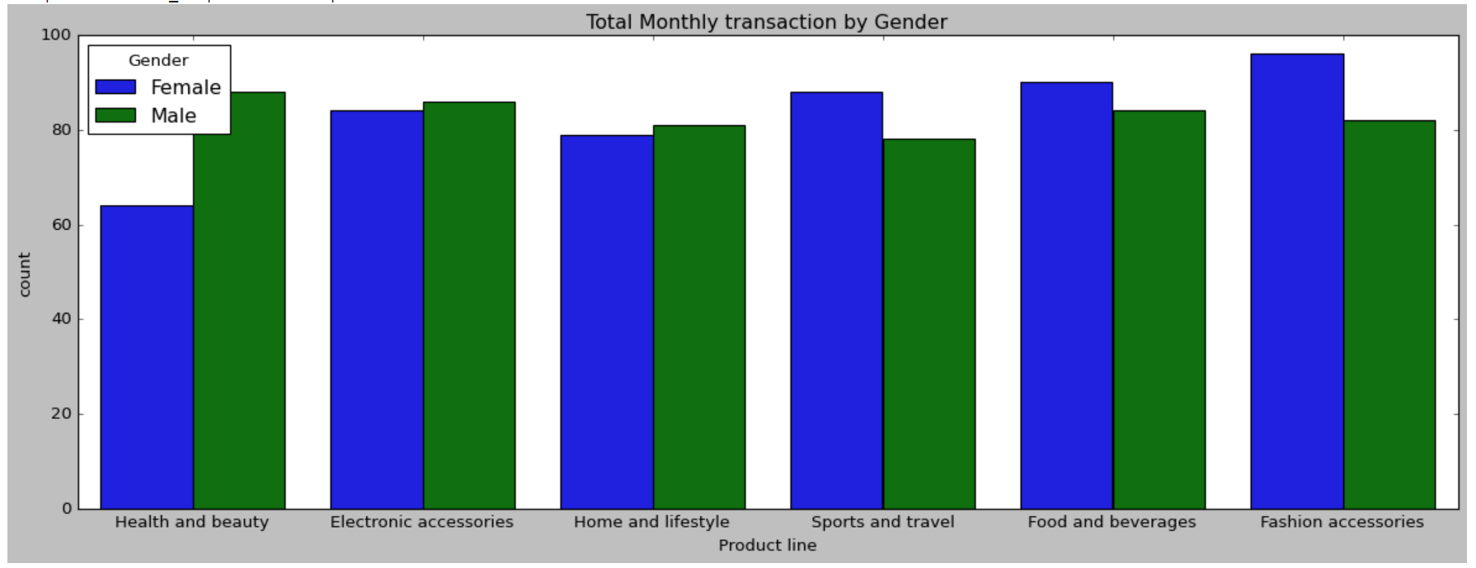
KEY FINDINGS: PRODUCTS Sales count of products by gender
spending patterns of
males and females, and in which category they spend a lot
Females spend on
'fashion accessories' the
most and for males it is
'Health and beauty’.
Females also spend
more on 'Sports and travel'.

Slide 12
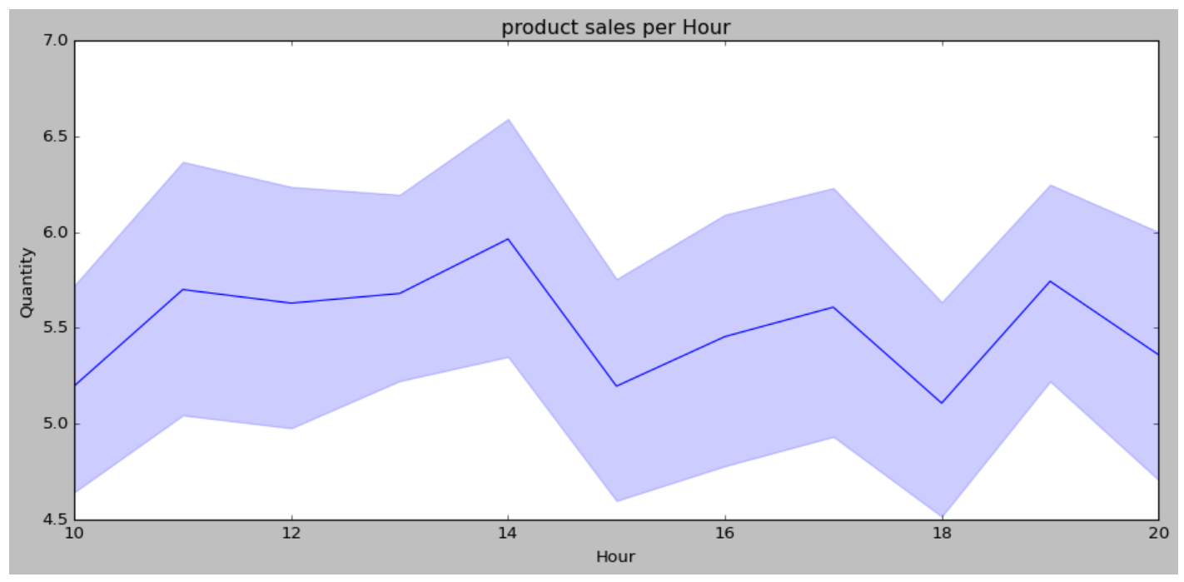
KEY FINDINGS: SALES Maximum sales time
Supermarket makes most of
its sales in 14:00 hrs
local time

Slide 13
ANALYSIS FOR CUSTOMERS

Slide 14
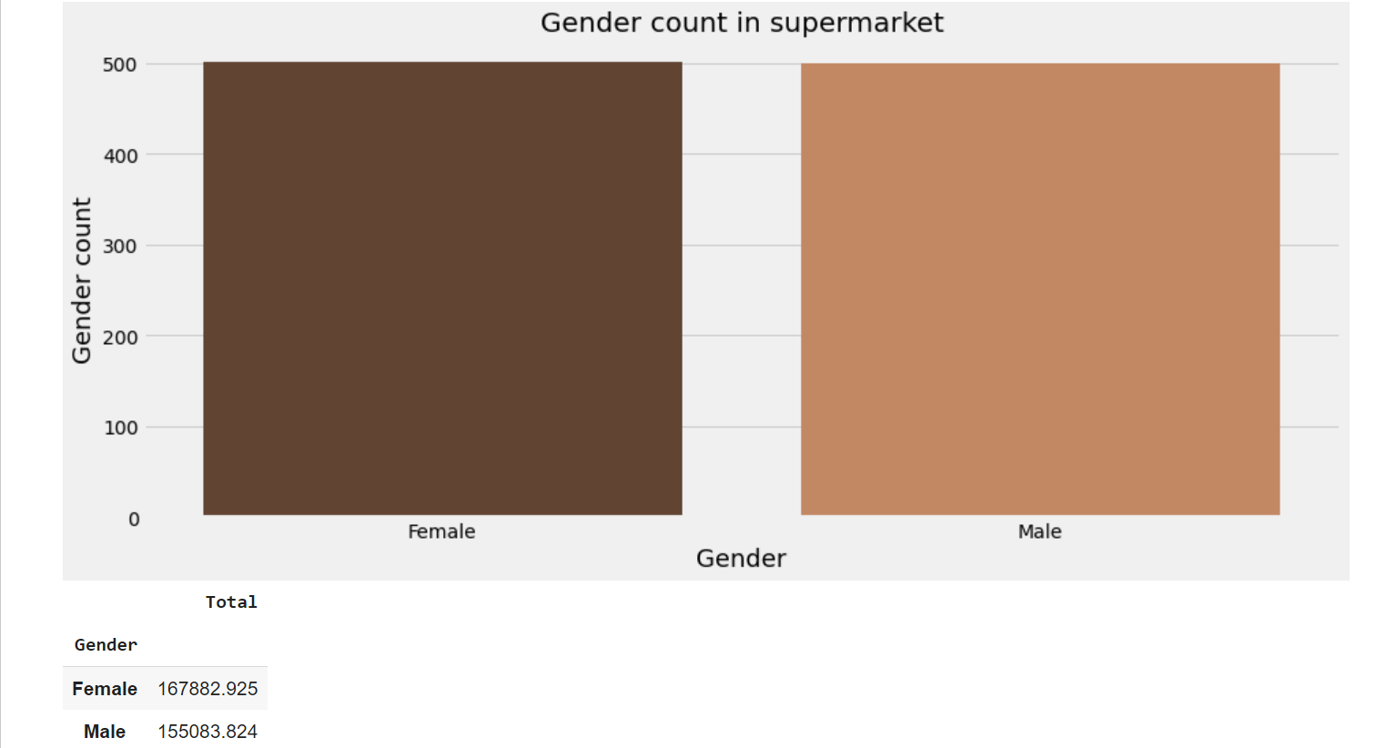
KEY FINDINGS: CUSTOMERS Genders
The numbers of male and female customers are almost the same

Slide 15
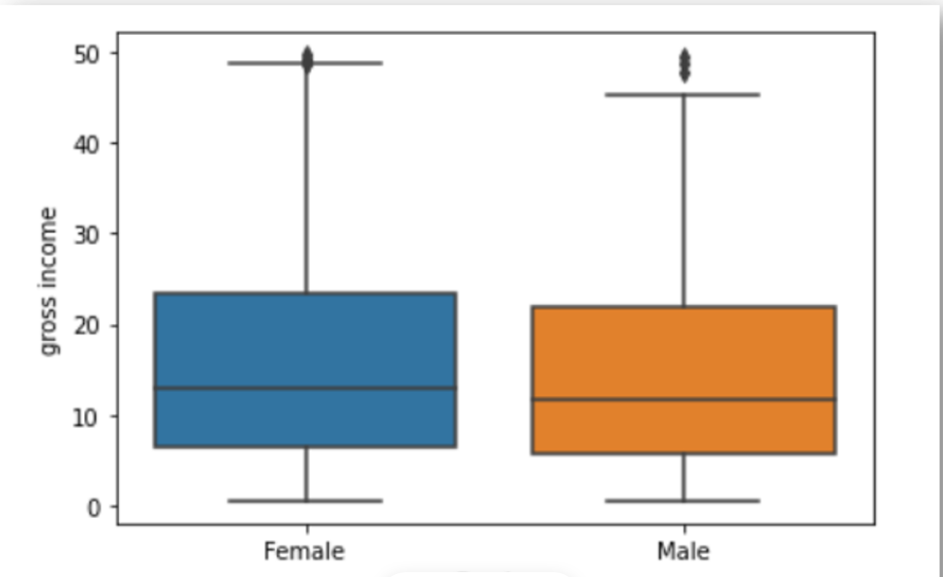
KEY FINDINGS: CUSTOMERS Relationship between genders and gross income
Gross income is similar for both male and female, though female customers spend a bit higher at the 75th percentile.

Slide 16
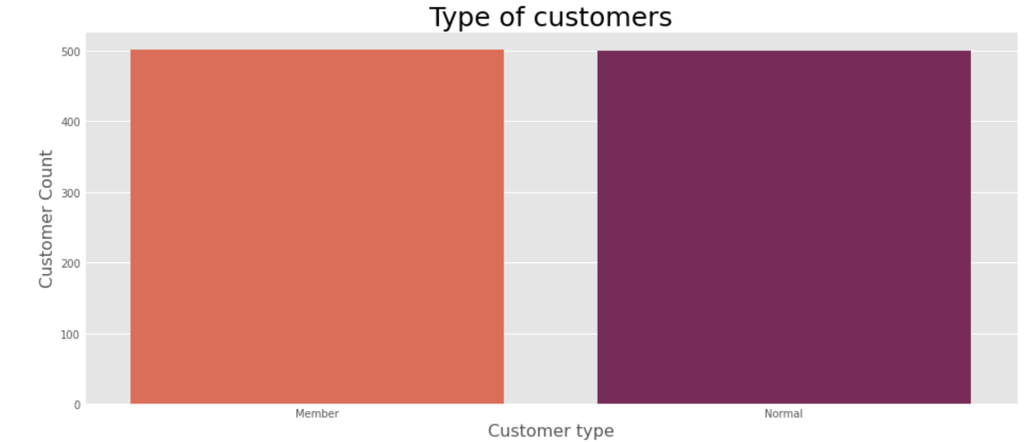
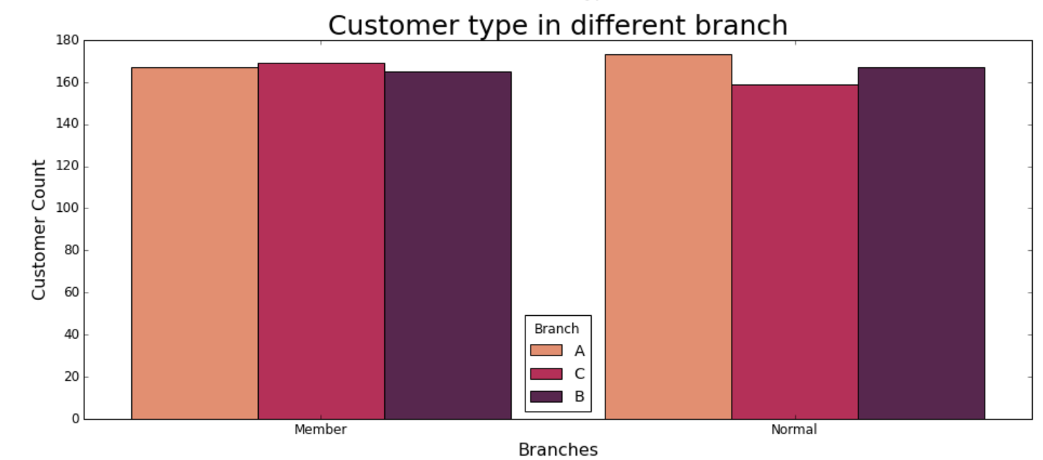
KEY FINDINGS: CUSTOMERS Types
The numbers of member and non-member customers are almost the same in all branches combined
The numbers of member and non-member customers are almost the same in different branches, but there is notably more member customers as opposed to non-member customers in Branch C

Slide 17
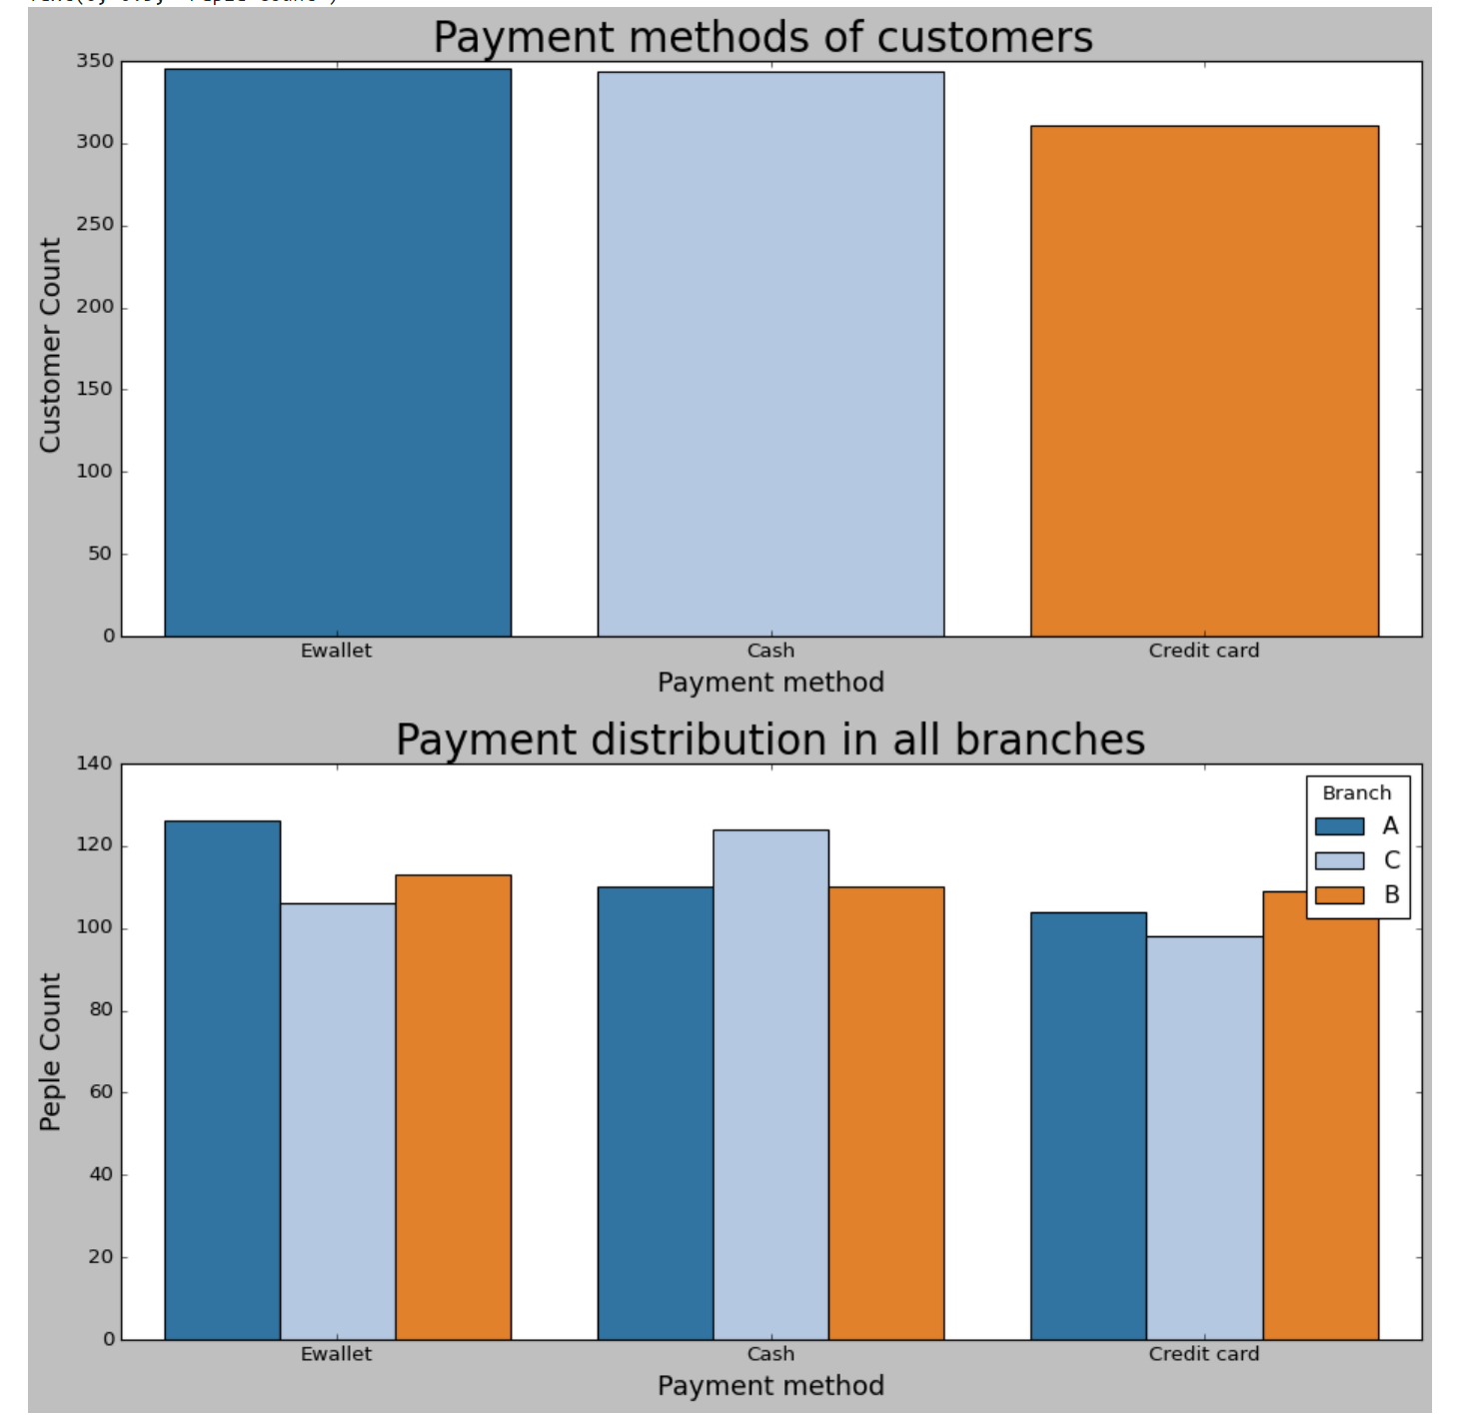
KEY FINDINGS: CUSTOMERS Payment methods
The most popular payment method is in-fact
E-wallet and not credit cards.
- Cash payment is also popular.

Slide 18
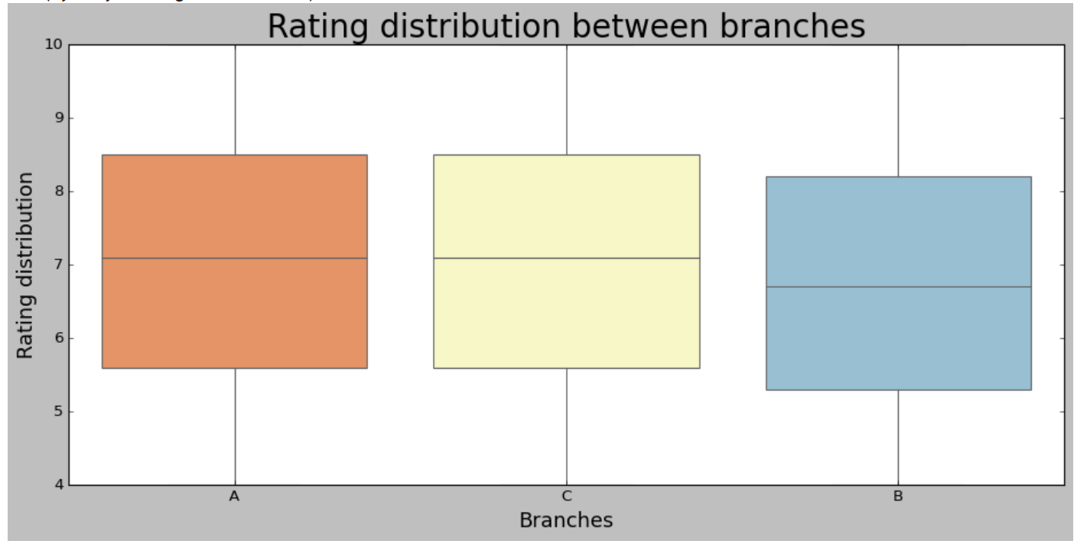
KEY FINDINGS: CUSTOMERS Ratings
50% of customers rated between 5 to 9 in both branches A and C
However, in Branch B, the rating started at a lower level
the average rating of branch A and C is more than seven and branch B is less than 7

Slide 19
ANALYSIS FOR PRODUCTS

Slide 20
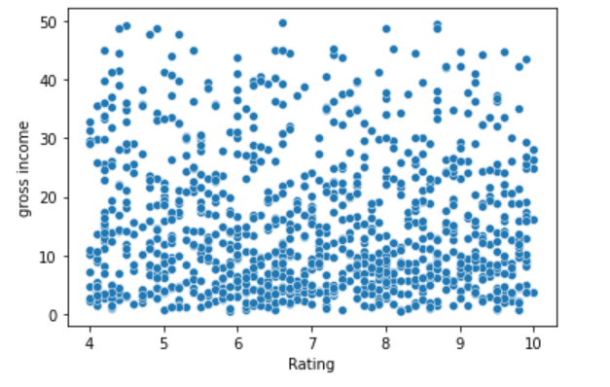
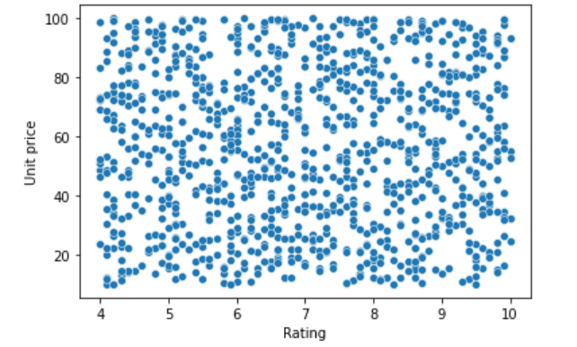
KEY FINDINGS: PRODUCTS Ratings
There is no correlation between ratings and gross income, or between ratings and unit price

Slide 21
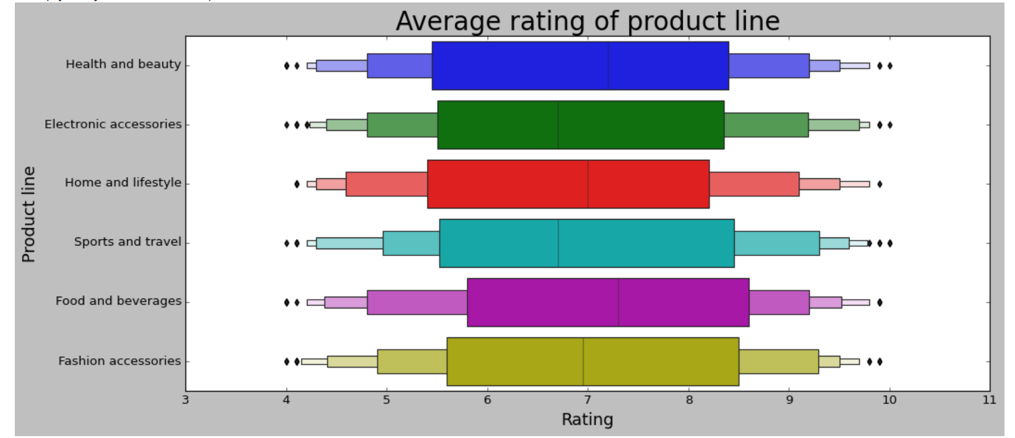
KEY FINDINGS: PRODUCTS Average rating of product line
There is no apparent difference in the rating between product lines
However, the median is slightly higher in Health and Beauty
The median (middle value) rating is 7

Slide 22
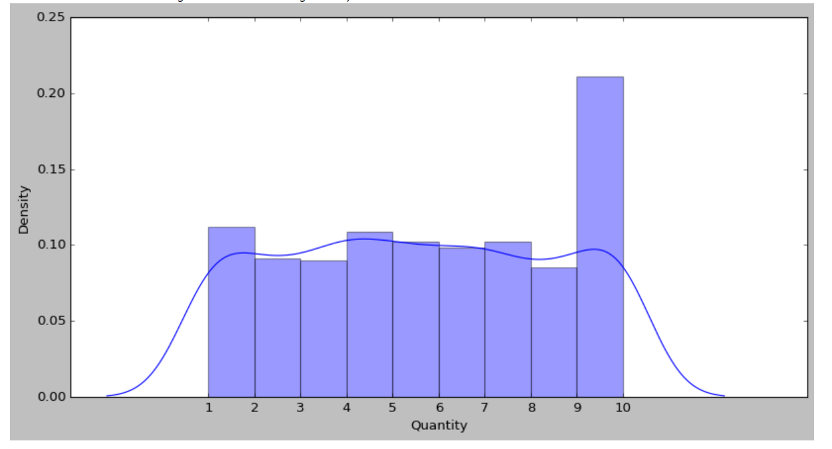
KEY FINDINGS: PRODUCTS Number of products customers buy
Most customers buy 10 quantities

Slide 23

PART 2: PREDICTIONS
Which is/are the busiest day/s for Supermarket Delta in 2020?

Slide 24
METHODOLOGY: XGBRegressor
Why XGBRegressor?
execution speed and model performance
it dominates structured or tabular datasets on classification and regression predictive modeling problems (it is the go-to algorithm for competition winners on the Kaggle competitive data science platform)
is a powerful approach for building supervised regression : it tells how far the model results are from the real values.

Slide 25
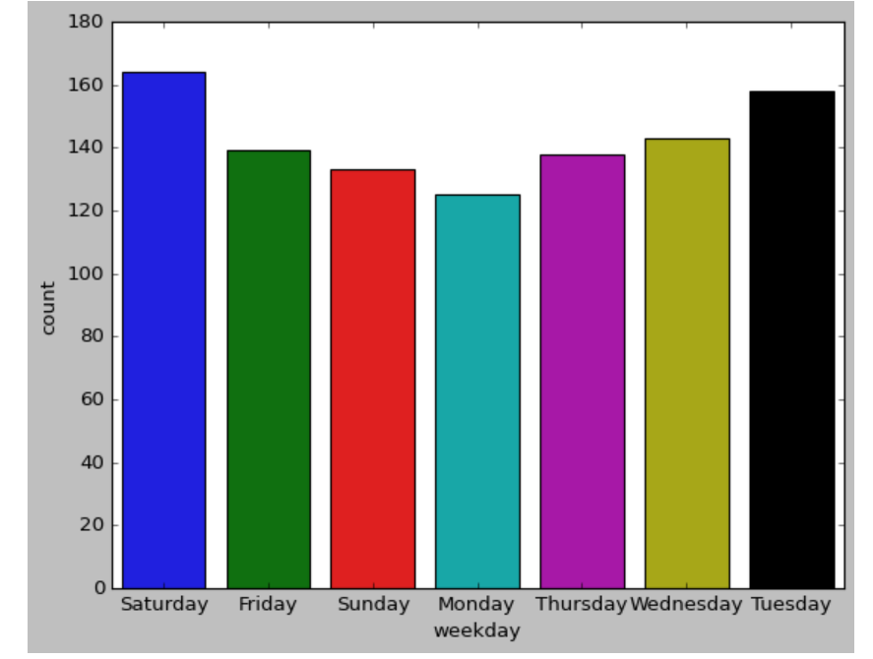
STEP 1: VISUALISNG DAYS OF WEEK FOR SALES
Steps:
Created a new column to ‘convert’ dates data into days data and labelled it as ‘weekday’
Visualised the weekday column using matplotlib and seaborn
Output:
Saturday is the day most customers shop
Tuesday is surprisingly the second most often day customers shop

Slide 26
STEP 2: TRANSFORMING CATEGORICAL DATA
- Identifying the days
0 = Friday , 1 = Monday, 2 = Saturday, 3 = Sunday, 4 = Thursday, 5 = Tuesday, 6 = Wednesday

Slide 27
STEP 3: TRAIN AND TEST DATA

Slide 28
STEP 4: ANALYSIS AND EVALUATIONS

Slide 29
Access to codes
The Python code for this project can be accessed through my GitHub:
EdgeHill-Skills-Bootcamp/Mini_Project_Task1.ipynb at main · FennyAmalo/EdgeHill-Skills-Bootcamp (github.com)
EdgeHill-Skills-Bootcamp/Mini_Project_Task_2.ipynb at main · FennyAmalo/EdgeHill-Skills-Bootcamp (github.com)

